Slide 1



SAMYUKTHA .G (211422104423)
SAIMA NOOREEN .S (211422104417)
BATCH: C1
GUIDE NAME:DR.M.S.VINMATHI

Slide 2
ABSTRACT:
Agriculture is a cornerstone of global food security and economic growth.
Accurate crop yield prediction is essential for optimizing resource allocation, improving agricultural planning, and addressing the challenges of global food security.
Machine learning techniques, particularly the Decision Tree algorithm, have emerged as powerful tools for forecasting crop yields.
By analyzing historical crop yield data in combination with meteorological and agricultural variables, these models enhance prediction accuracy.
The Decision Tree algorithm is especially effective due to its ability to handle both categorical and continuous variables, making it suitable for uncovering complex relationships within the data.
This integration of agriculture with data science offers a promising pathway for promoting sustainable farming practices and supporting informed decision making on a global scale.

Slide 3

Crop Yield Prediction using Machine Learning
Crop yield prediction is a vital aspect of modern agriculture, enabling farmers to optimize resource allocation and ensure food security. Machine learning algorithms can analyze vast amounts of data to predict crop yields, providing valuable insights for informed decision-making.

Slide 4
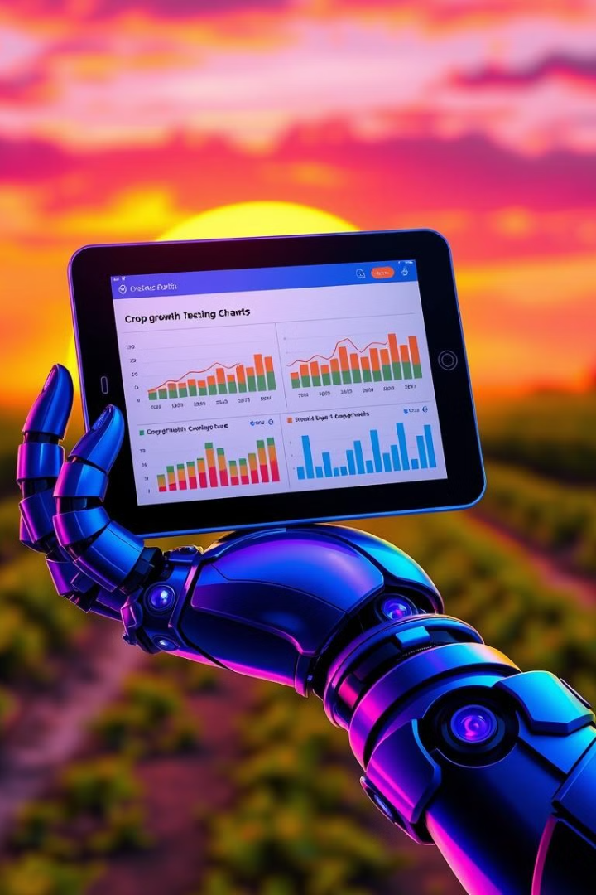
Introduction to Crop Yield Prediction
Crop yield prediction aims to forecast the amount of produce that can be harvested from a given area. This involves analyzing factors like weather conditions, soil type, and crop variety.
1
Data-Driven Approach
2
Improved Resource Management
Machine learning algorithms can learn complex relationships within data to make accurate predictions.
Accurate predictions can help farmers optimize water usage, fertilizer application, and other resources.
3
Enhanced Decision Making
Farmers can adjust their planting schedules and manage risks based on yield predictions.

Slide 5
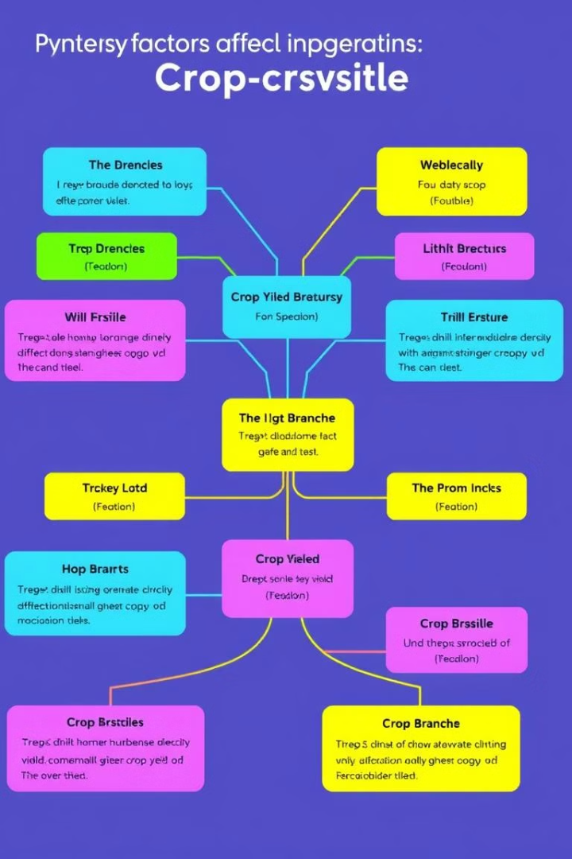
Decision Tree Algorithm
The decision tree algorithm is a supervised learning technique used for classification and regression. It constructs a tree-like model to predict a target variable based on various input features.
1
Splitting Data
The algorithm divides the data into subsets based on the most informative feature.
2
Decision Nodes
Each node in the tree represents a decision based on a particular feature.
3
Leaf Nodes
The final nodes of the tree predict the output, representing the yield prediction.

Slide 6
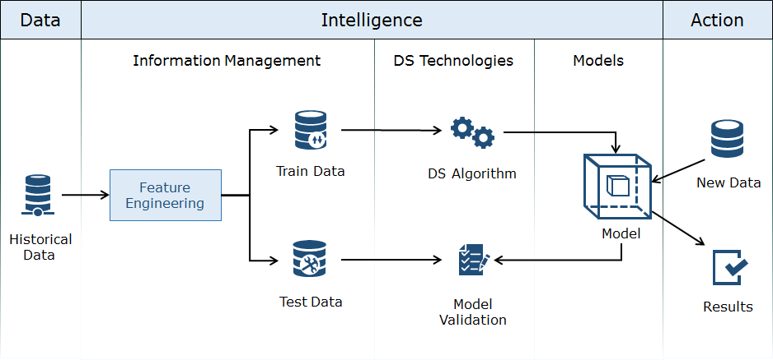
ARCHITECTURE DIAGRAM:

Slide 7
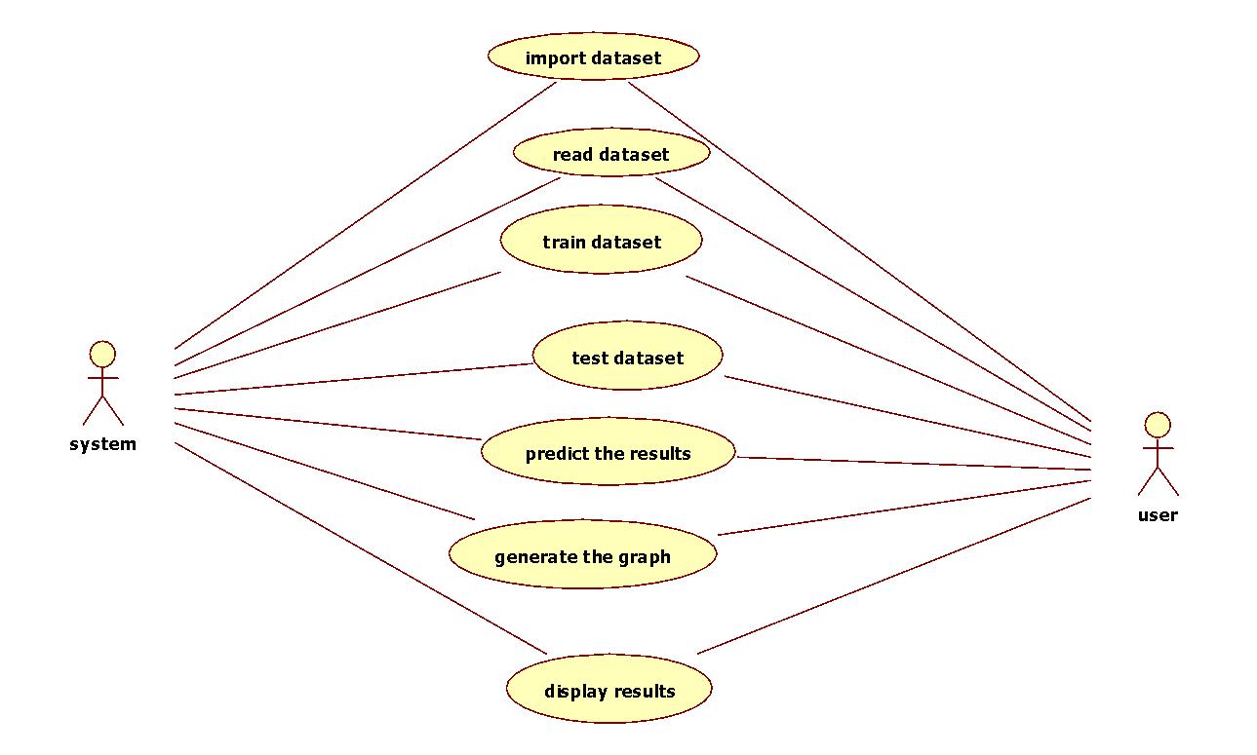
UML DIAGRAMS
USE CASE DIAGRAM

Slide 8
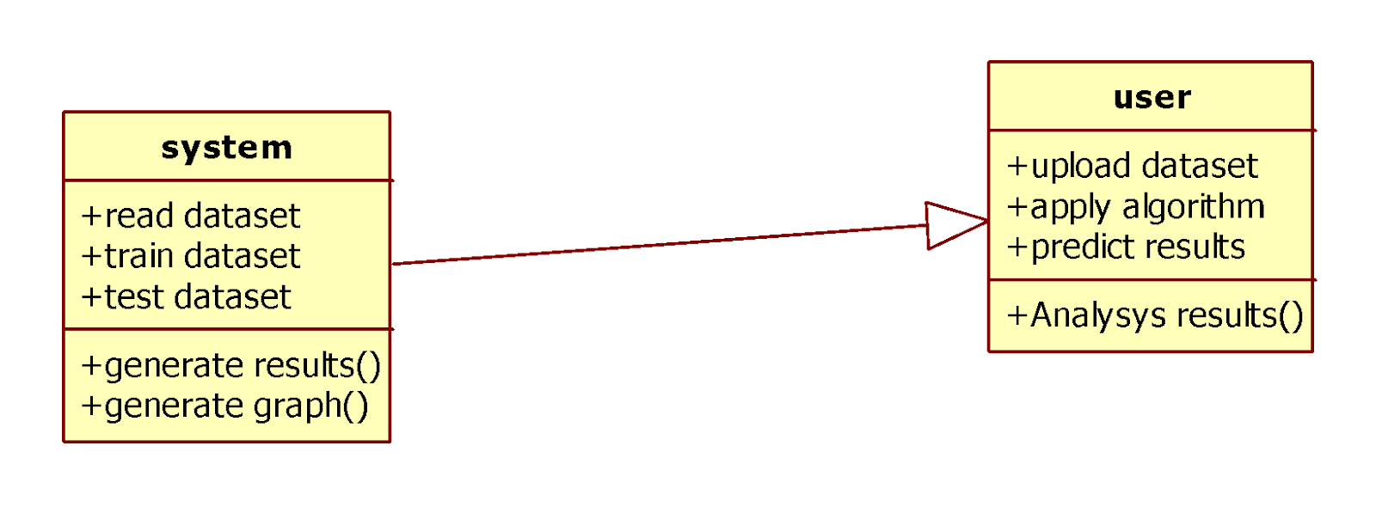
CLASS DIAGRAM

Slide 9
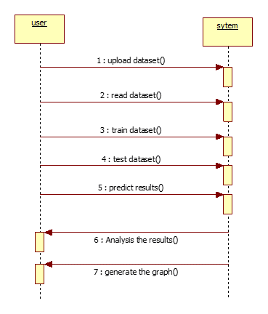
SEQUENCE DIAGRAM

Slide 10
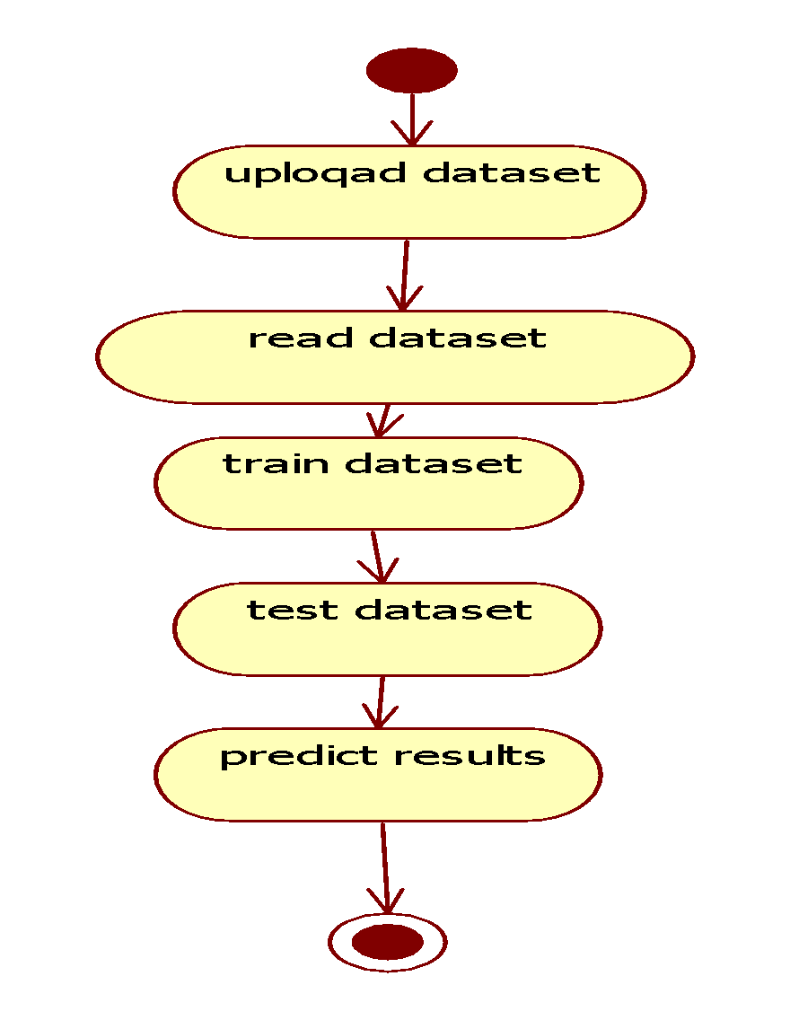
ACTIVITY DIAGRAM

Slide 11
Data Collection and Preprocessing
Data collection is a crucial step, encompassing various sources like weather stations, soil sensors, and satellite imagery. Preprocessing ensures data quality and prepares it for model training.
Data Sources
Data Cleaning
Feature Engineering
Weather data, soil analysis, historical crop yields, and satellite imagery.
Handling missing values, removing outliers, and transforming data formats.
Creating new features from existing data to improve model performance.

Slide 12




Model Training and Evaluation
The preprocessed data is used to train the decision tree model. Evaluation metrics determine the model's accuracy and performance.
Splitting Data
Dividing the data into training and testing sets.
Model Training
The decision tree model is trained using the training data.
Model Evaluation
Metrics like mean squared error (MSE) and R-squared (R²) are used to assess the model's accuracy.

Slide 13
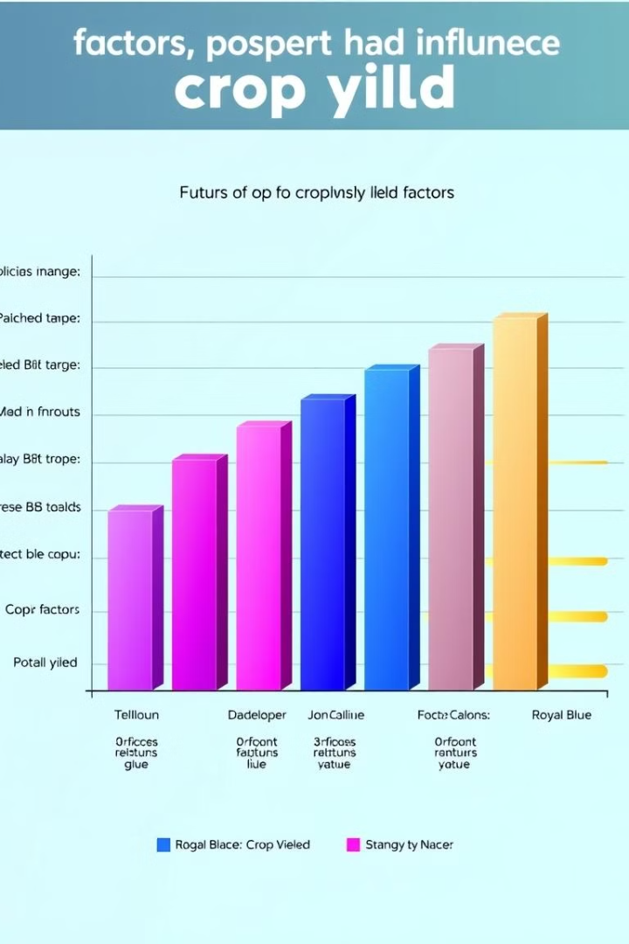
Feature Importance Analysis
Understanding the importance of different factors influencing crop yield provides insights for optimizing agricultural practices.
Feature
Importance
Rainfall
High
Temperature
Medium
Soil pH
Low

Slide 14

Conclusion and Future Scope
Machine learning algorithms, especially decision trees, offer a powerful tool for crop yield prediction. Future advancements in AI and sensor technologies will enhance prediction accuracy and enable more precise agricultural management.
Improved Accuracy
Real-Time Monitoring
Further research on model optimization and data integration can enhance prediction accuracy.
Developing real-time monitoring systems for crucial variables like weather and soil conditions can improve predictions.
Personalized Recommendations
AI-driven systems can provide personalized recommendations to farmers based on their specific farm conditions.

Slide 15
REFERENCE:
[1] Shivam Bang, Akshaya Kumar Dixit Rajat Bishnoi, Indu Chawla,Ankit Singh Chauhan, “Predicting Crop Yield using Fuzzy
Logic using ARMA, SARIMA, and ARMAX Model Predicted Temperature and Rainfall Parameters, IEEE-2019
[2] Aruvansh Nigam, Saksham Garg, Parul Agarwal, Archit Agarwal.“Crop yield prediction in Indian agriculture using machine
learning”,
[3] Potnuru Sai Nishant, Pinapa Sai Venkat, and Bollu Lakshmi Avinash B., “Crop Yield Prediction based on Indian Agriculture
using Machine Learning&quot;
[4] Dhivya Elavarasan and P. M. Durairaj Vincent., “Crop yield prediction using a deep reinforcement learning model for
environmentally responsible agricultural applications”,IEEE.
[5] Niketa Gandhi, Owaiz Petkar, Leisa J. Armstrong, and Amiya Kumar Tripathy &quot;Rice Crop Yield Prediction in India
UsingSupport Vector Machines,&quot;

